Slide 1
DIY Stereo Vision : Depth Estimation using Object Detection
Nitish V Poojari Yashwant Moharil

Slide 2
Camera Calibration

Slide 3
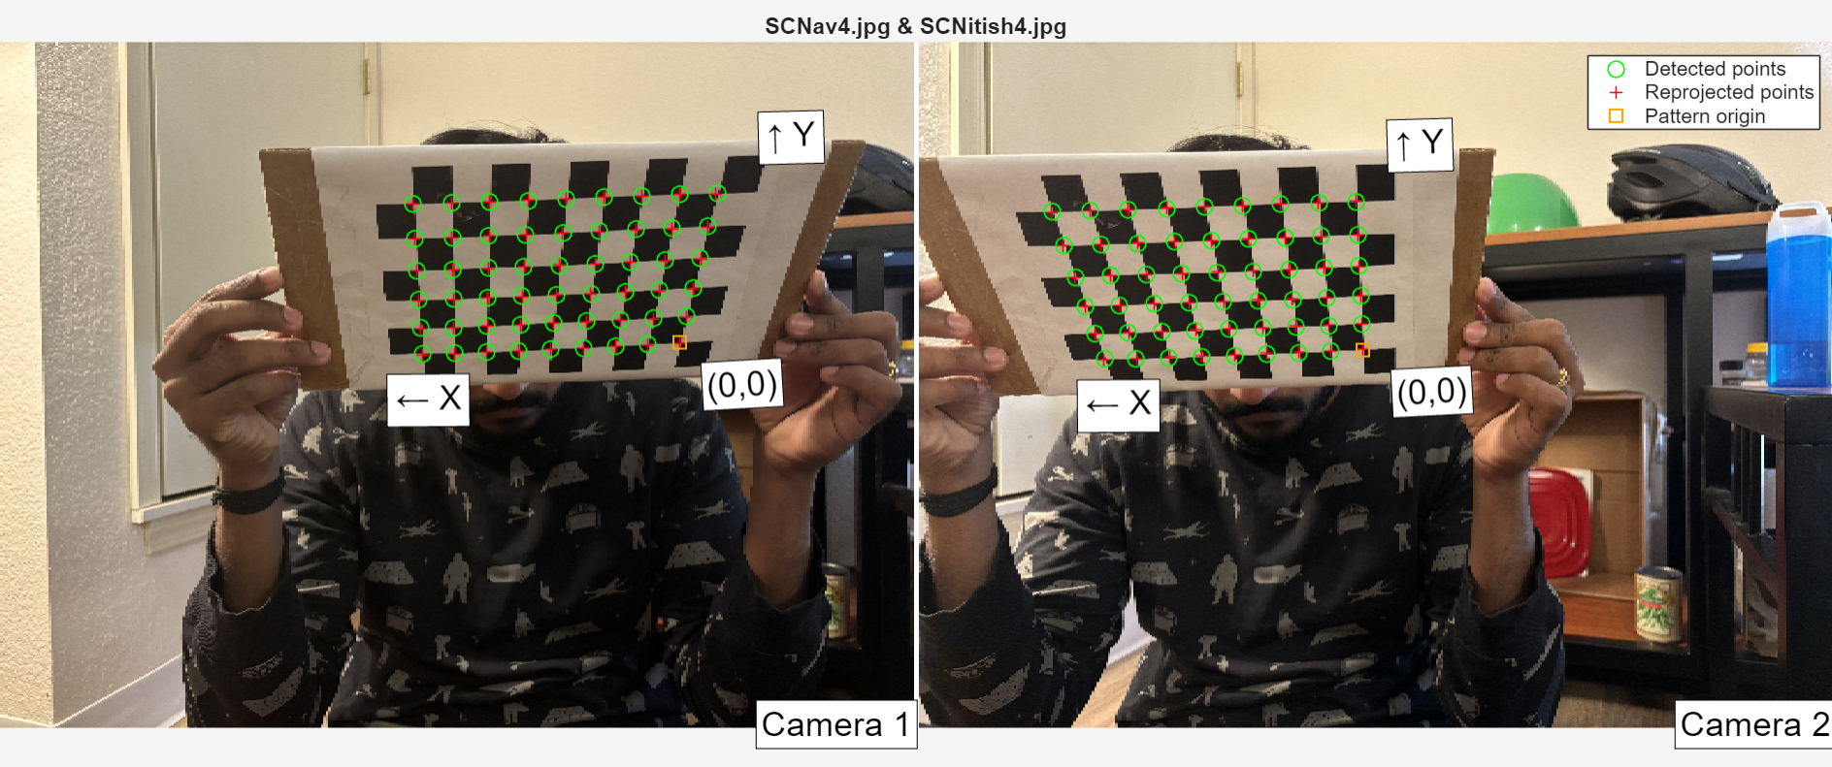
Stereo Calibration
Stereo Calibration first starts with finding the intrinsic parameters of both the cameras such as focal length etc. We achieved it by clicking 11 pictures each of a checkerboard from different planes.

Slide 4
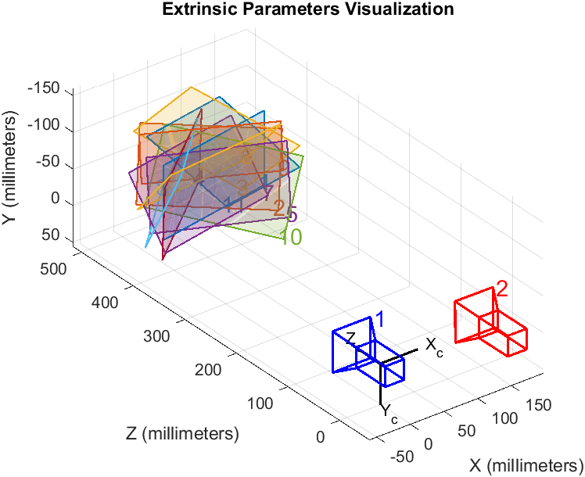
Stereo Calibration (contd.)
Next, the process calculates the extrinsic properties of one camera with respect to the other using the 11 pair of checkerboard photos. (Left wrt Right in our project)
Post this, we need to eradicate the outliers to minimize the mean error.
The Extrinsic Evaluation :

Slide 5
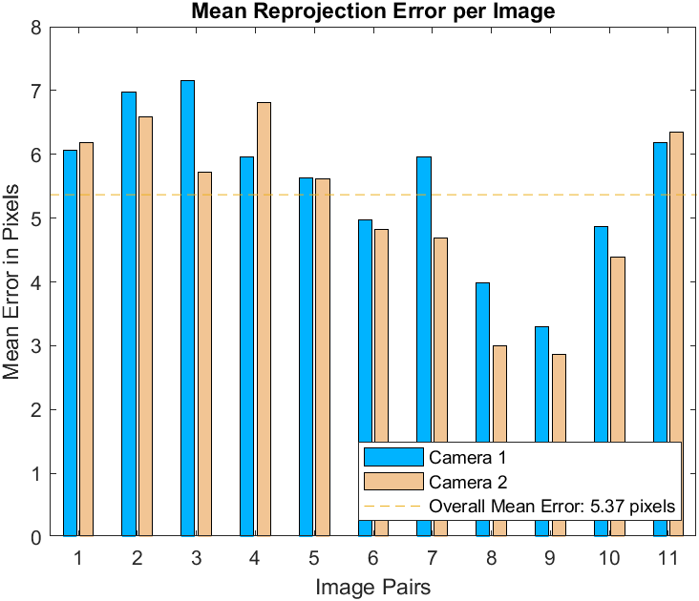
Stereo Calibration (Contd.)
Before eradicating the outliers:

Slide 6
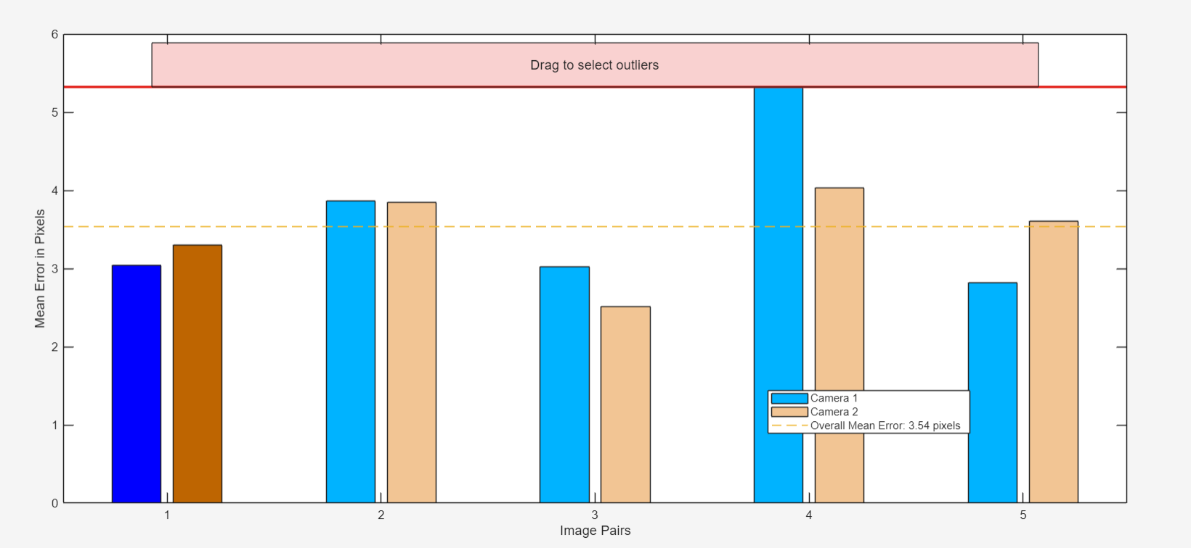
Stereo Calibration (contd.)
After removing the outliers:

Slide 7
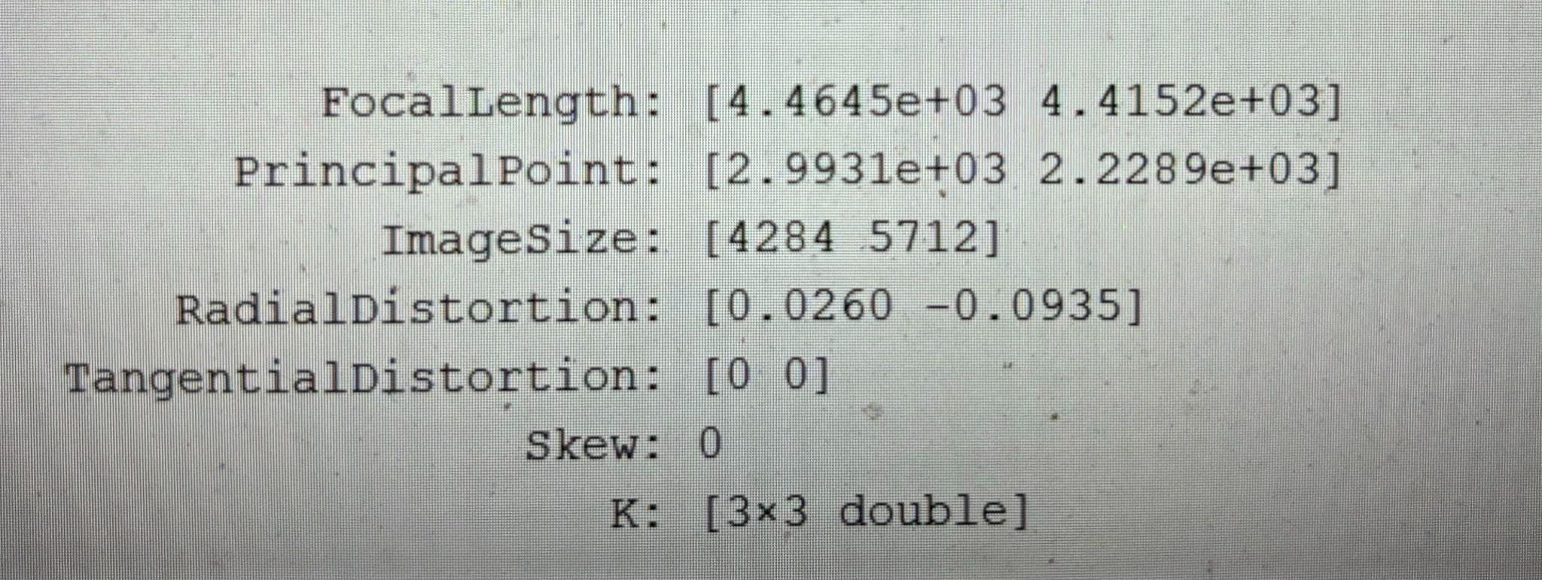
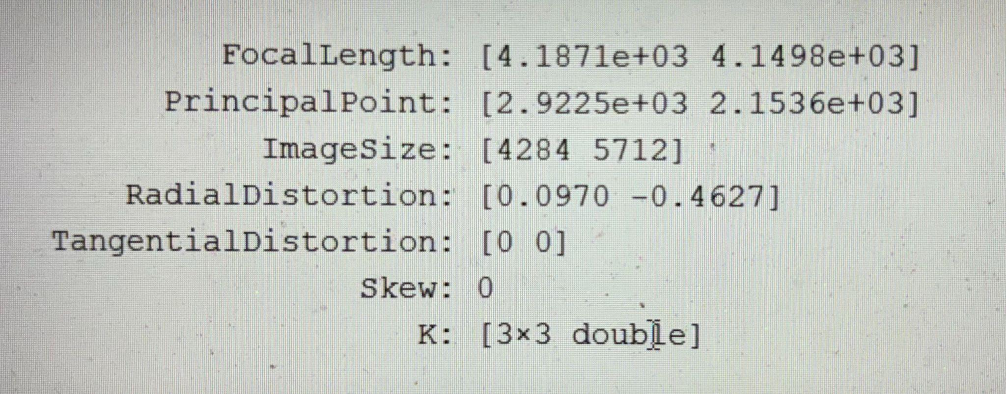
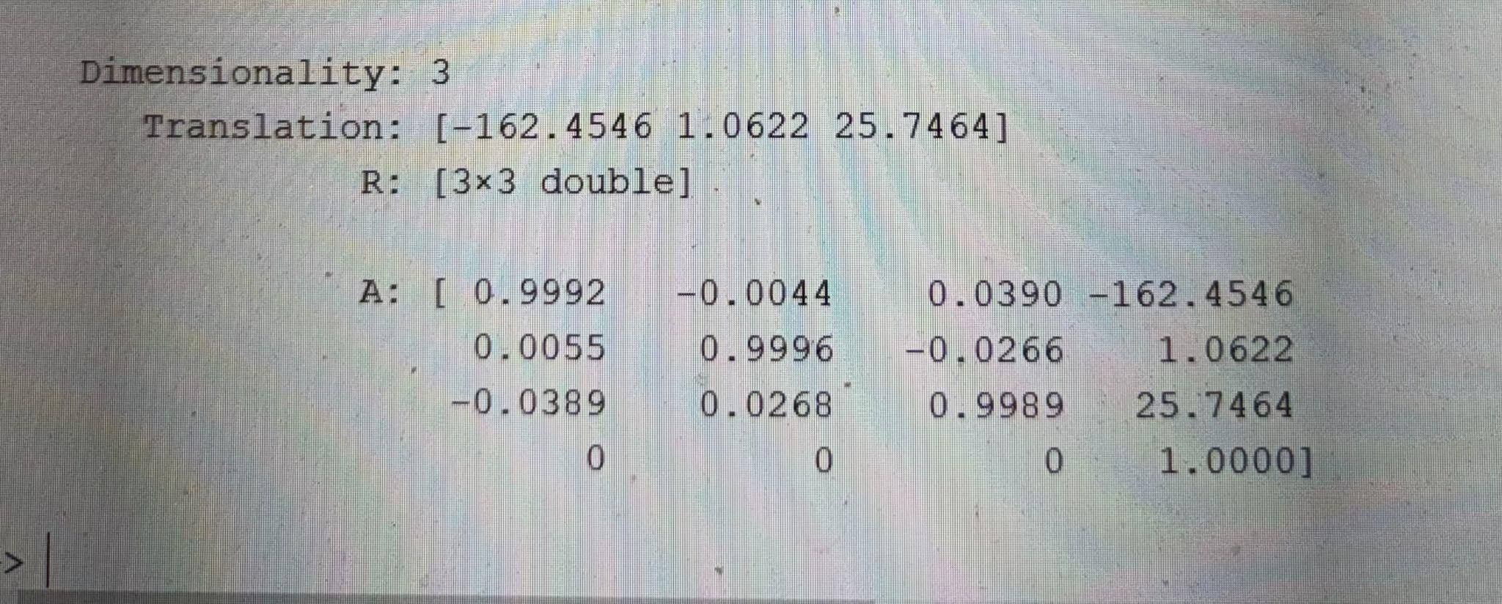
Intrinsic of Left Camera:
Intrinsic of Right Camera:
Extrinsic Parameters:

Slide 8
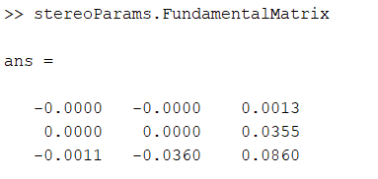
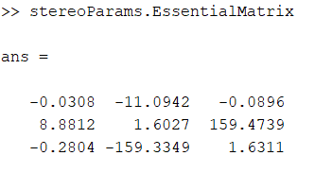
Fundamental and Essential Matrix:

Slide 9
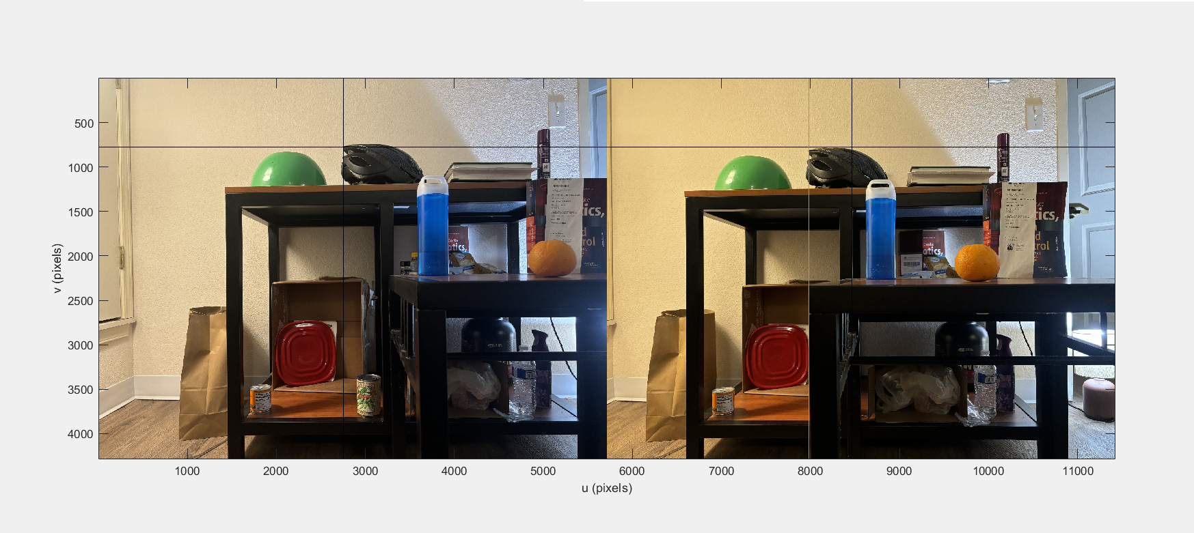
Stereo Pair Rectification
Before Rectification:

Slide 10
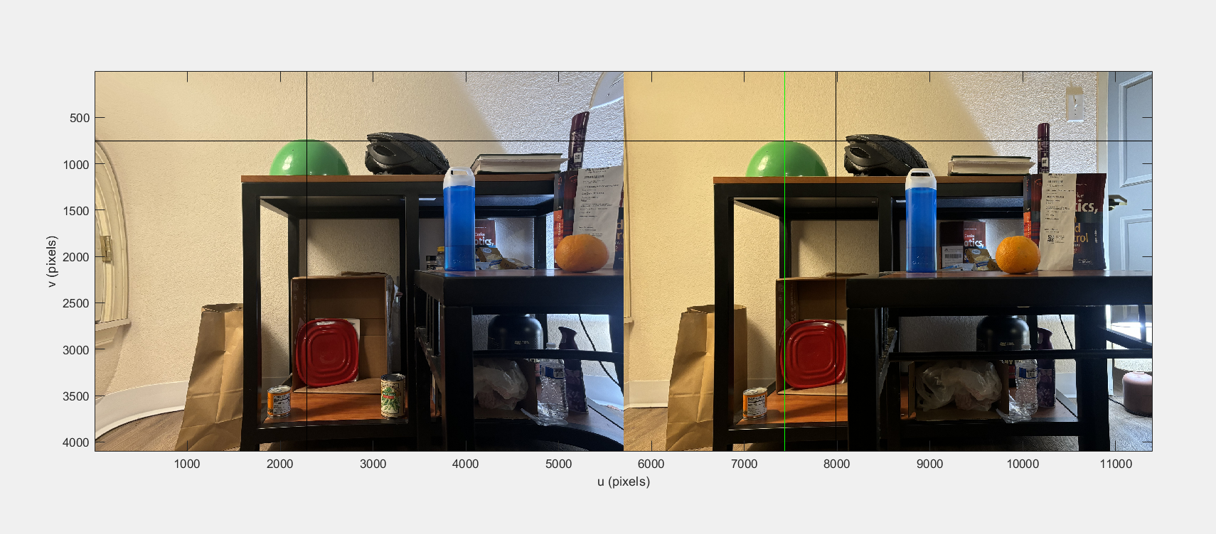
Stereo Pair Rectification (contd.)
After Rectification:

Slide 11
Depth Estimation and Object Detection

Slide 12
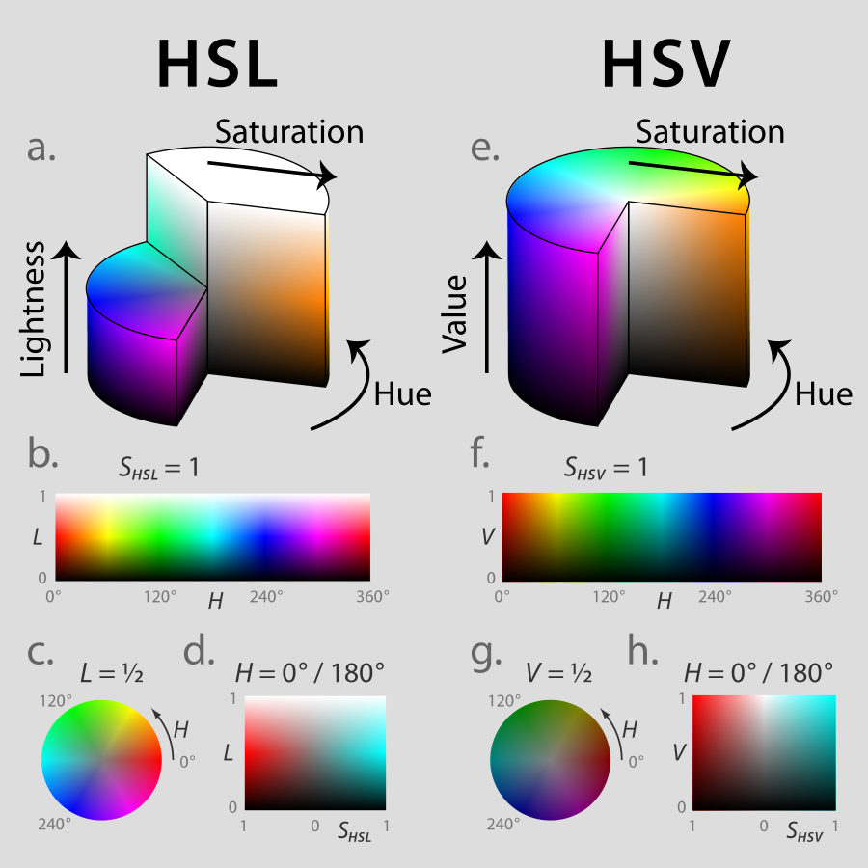
H(color)S(intensity)V(brightness) Model
Several good reasons for using HSV (Hue, Saturation, Value) color space for object detection:
Hue represents the actual color, Saturation and Value can handle shadows better
Easier thresholding
Hue, emphasises on color rather than the brightness.
efficient morphological operations

Slide 13
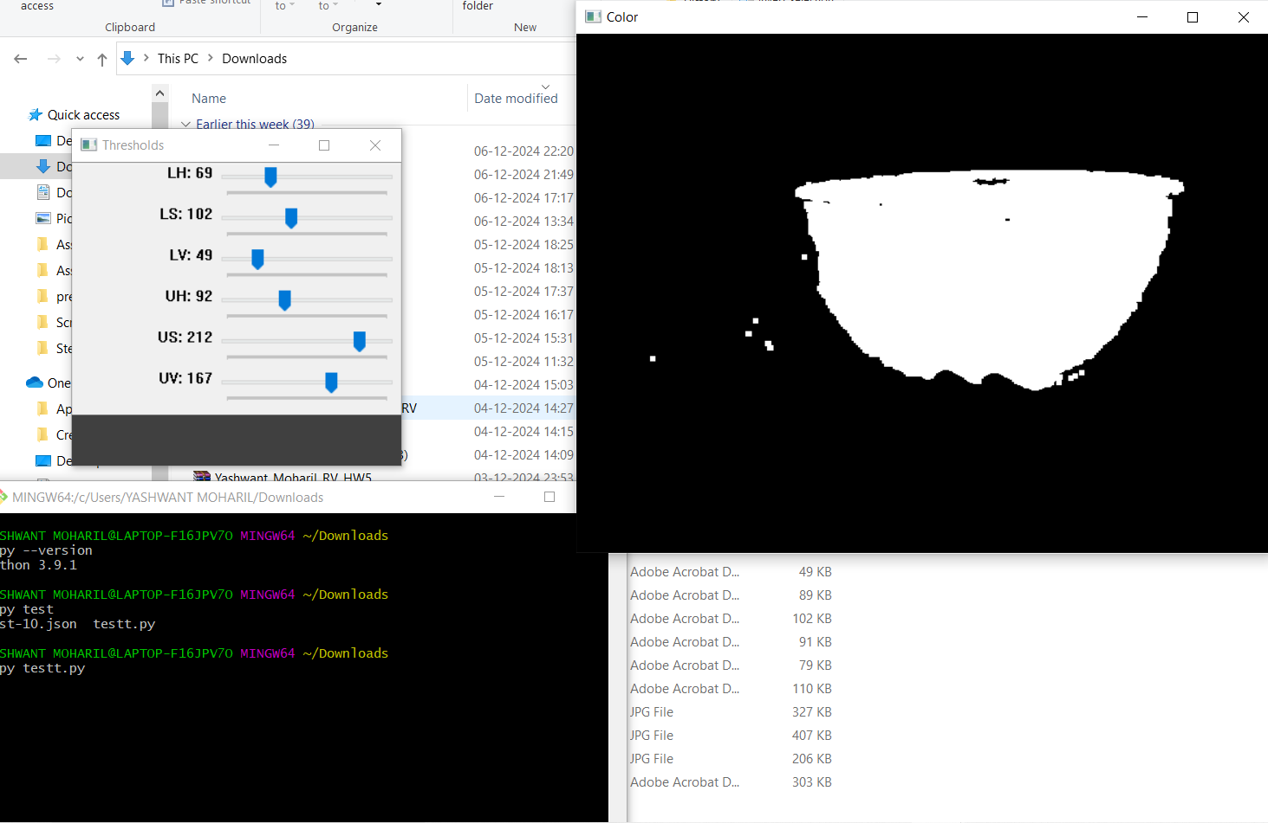
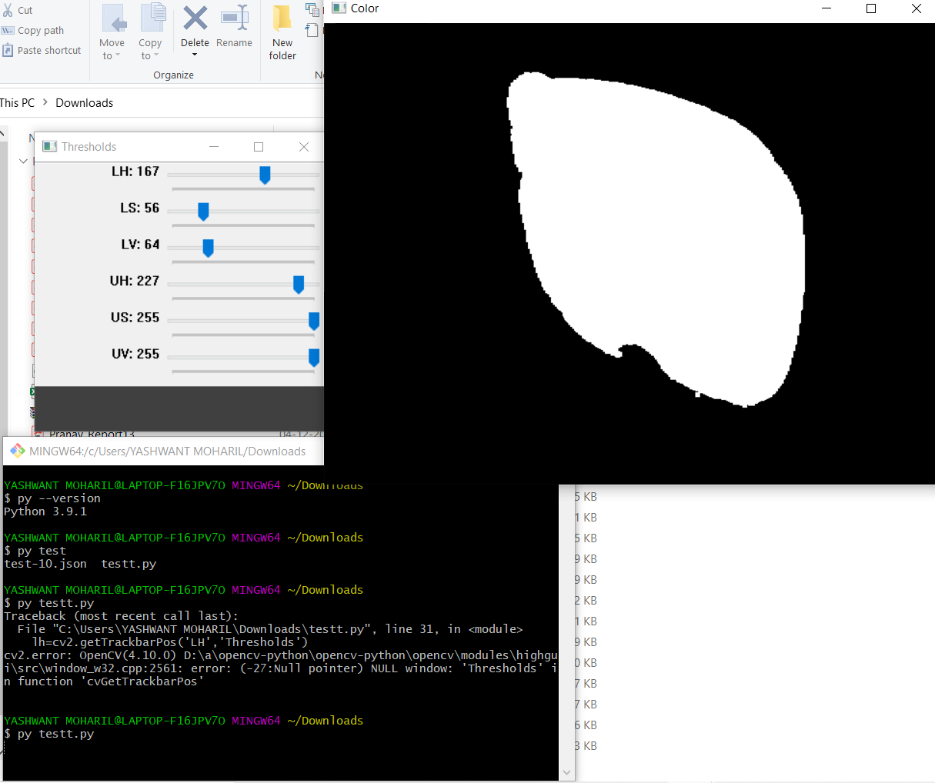
H(color)S(intensity)V(brightness) Model (contd.)
A Binary logical Filter that helps segment each frame of video to focus on region of interest, Binary 1 → Good and Binary → 0 Bad!

Slide 14
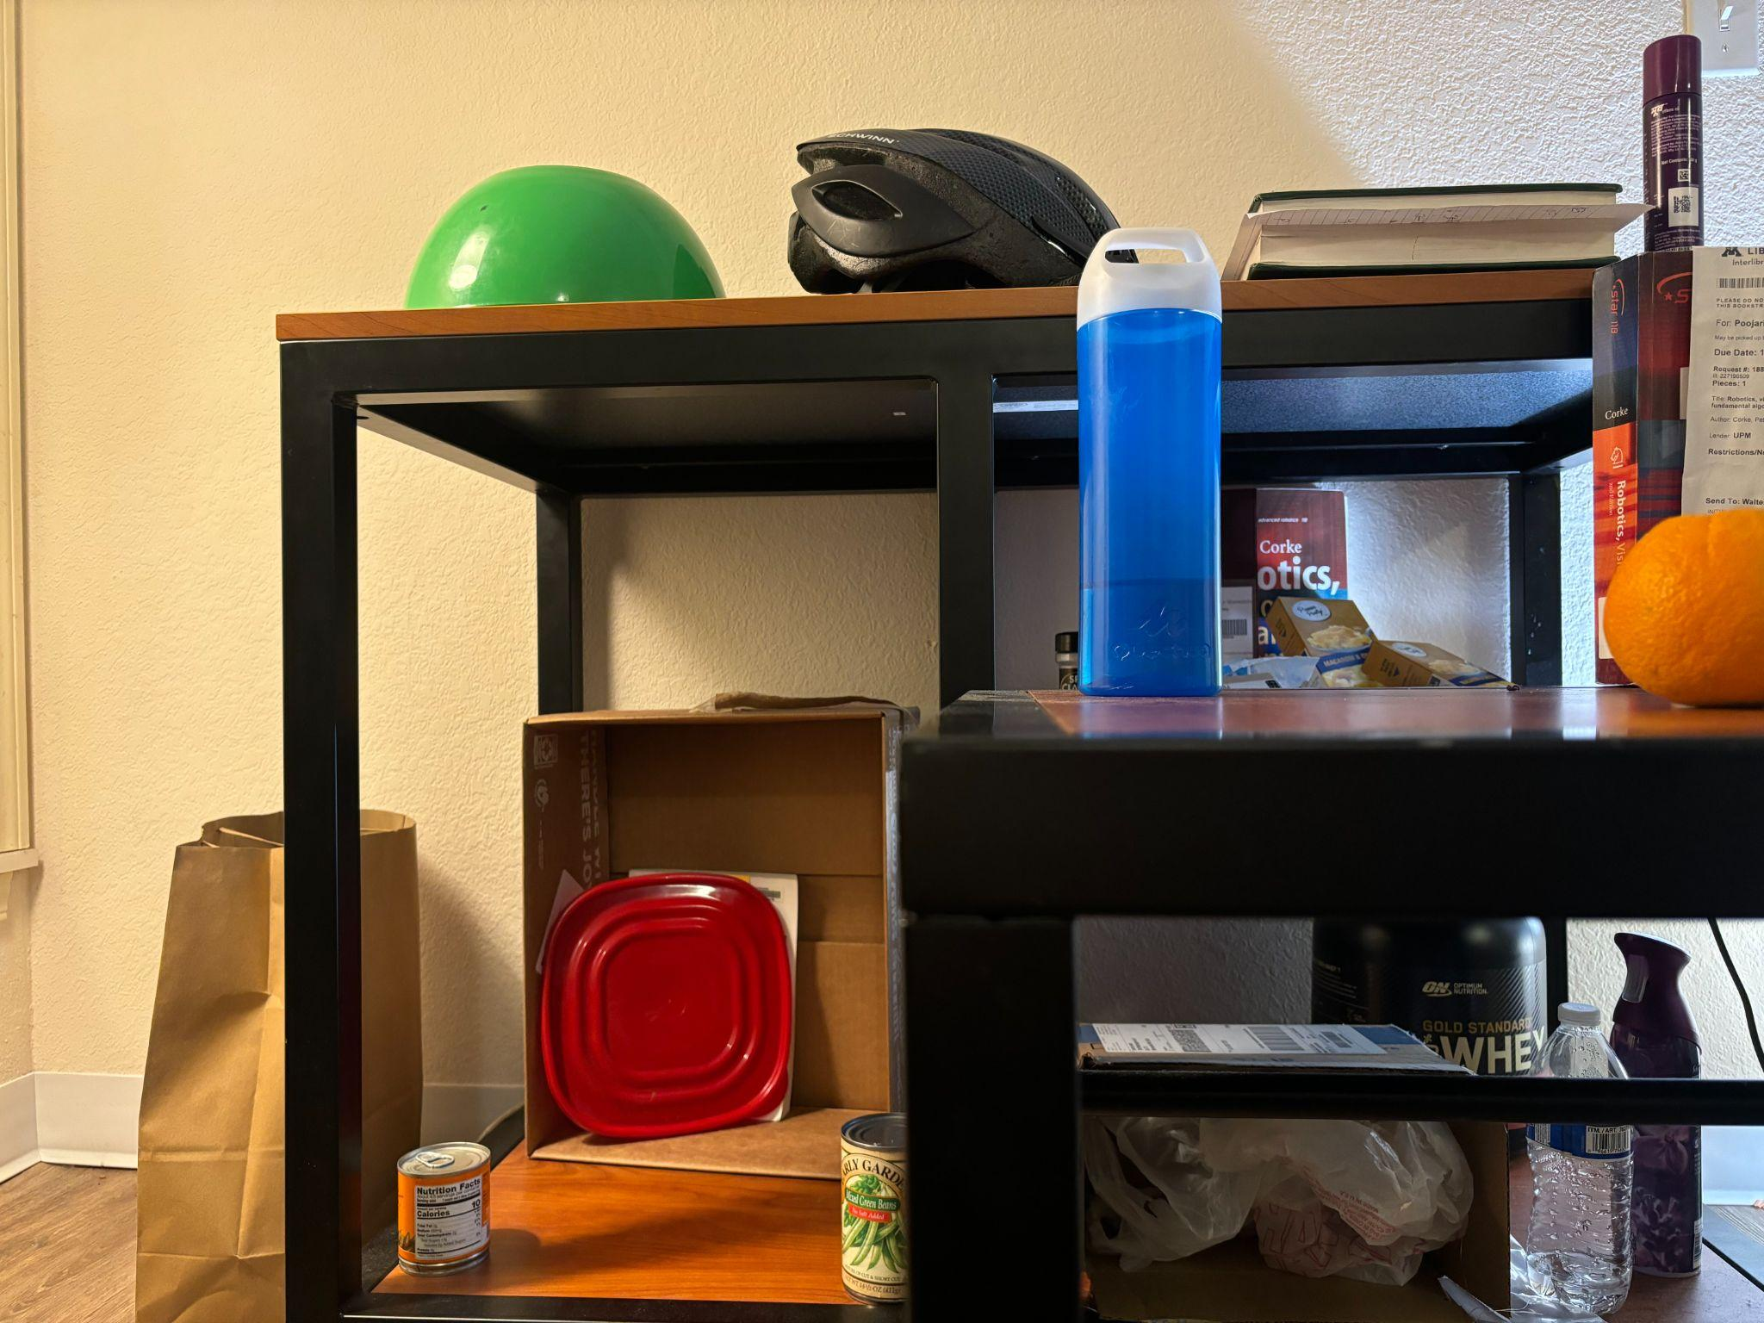
Masking

Slide 15
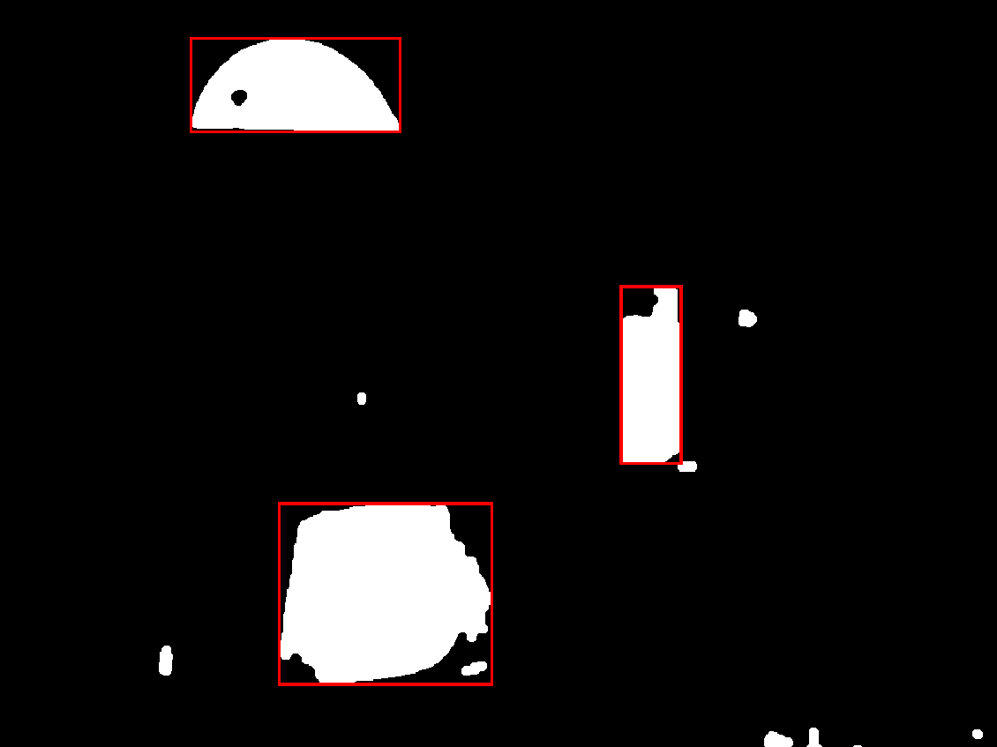
Masking

Slide 16
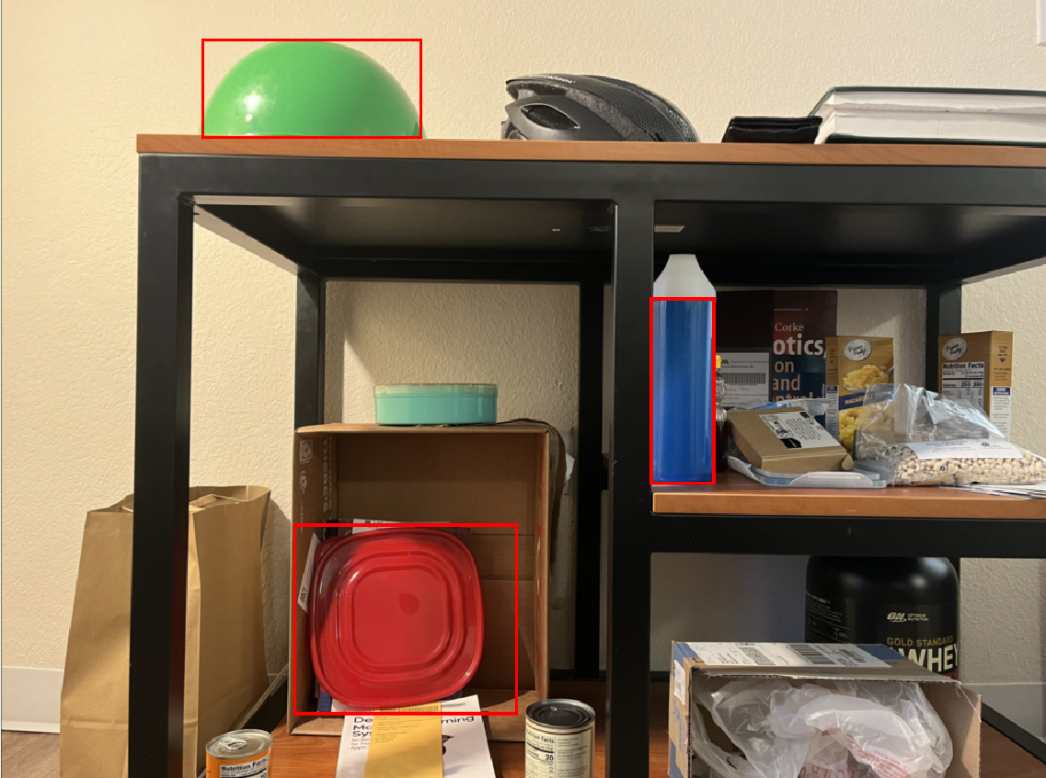
Detection and Disparity

Slide 17

Detection and Disparity (contd.)

Slide 18
Detection and Disparity (Wrap up)

Slide 19
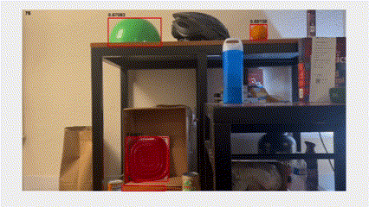
Thank you…

Slide 20


